Slide 1
Reinforcement Learning Framework
Codebase: https://github.com/tianbingsz/WALL-E

Slide 2
MileStone Contribution
A long term Reinfocement Learning project to develop an efficient, yet simple RL framework
The Rollout Time (experience collection) is a bottleneck
Achieve near linear speedup for Rollout Time with multi-process architectural support

Slide 3
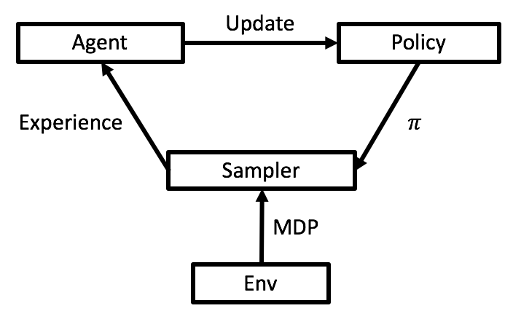
General Reinforcement Learning Framework

Slide 4
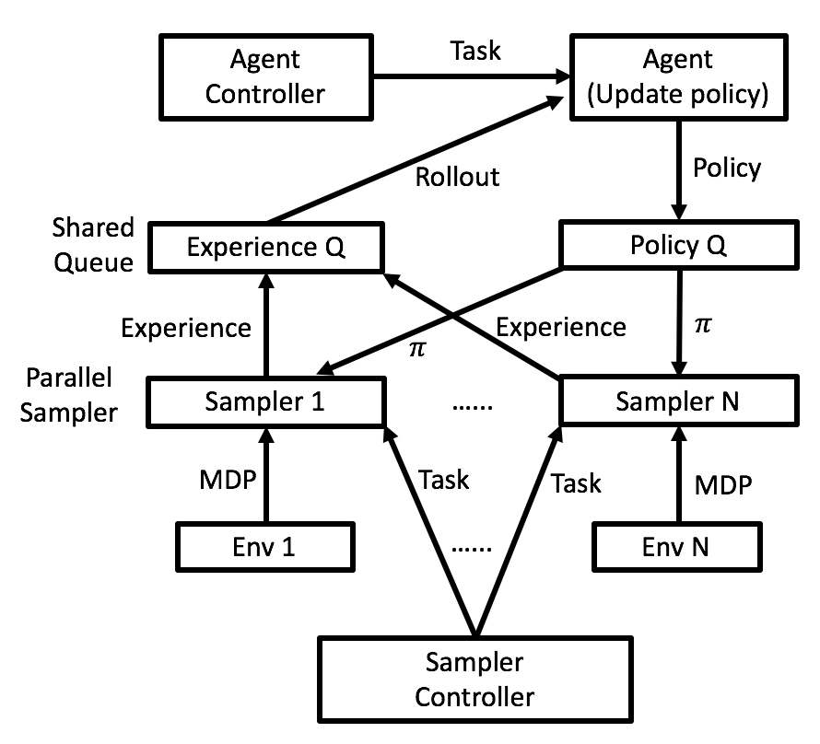
RL Framework with Multi-Process Experience Collection

Slide 5
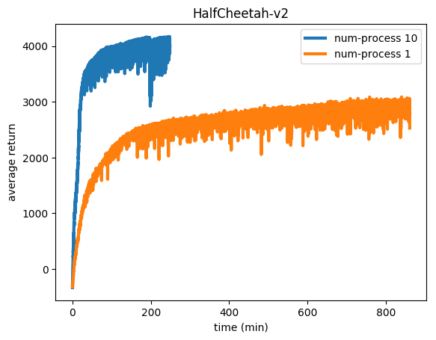
Result on Mujuco Control task

Slide 6
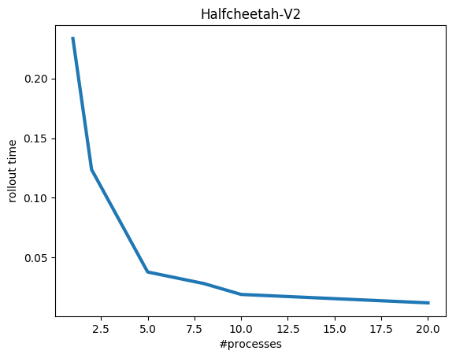
Rollout time Reduction w.r.t Processes

Slide 7
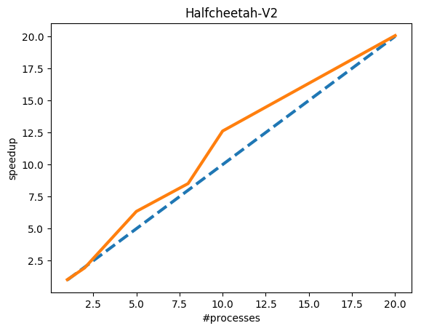
Rollout time (near linear) Speedup

Slide 8
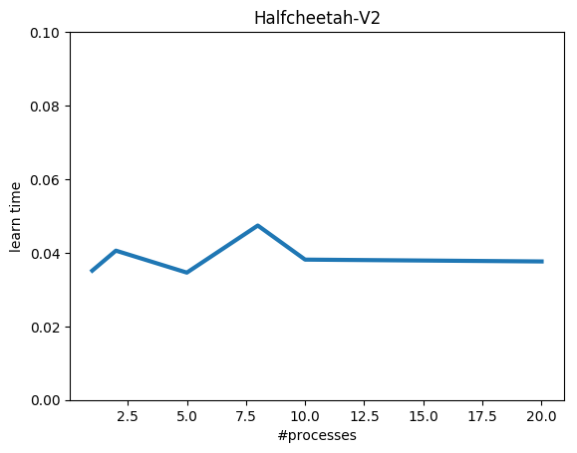
Policy Learning Time w.r.t. Processes

Slide 9
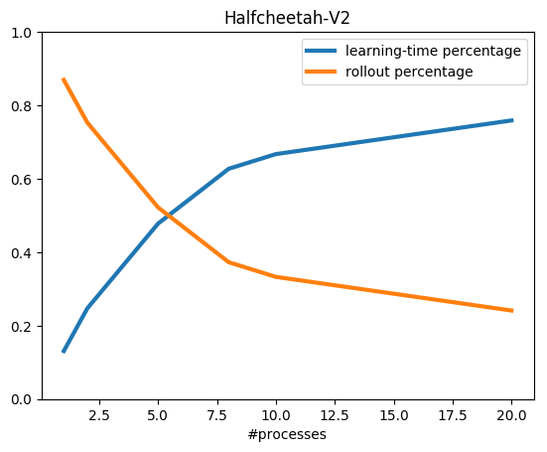
Running Time = Rollout Time + Policy Learning Time

Slide 10
Future work
Speedup Policy Learning (Perception to Control Policy Network) with Multi-GPU support
Generalize the codebase to support off-policy learning
Model-based RL, Planning, Exploration and more for Robotics

Slide 11
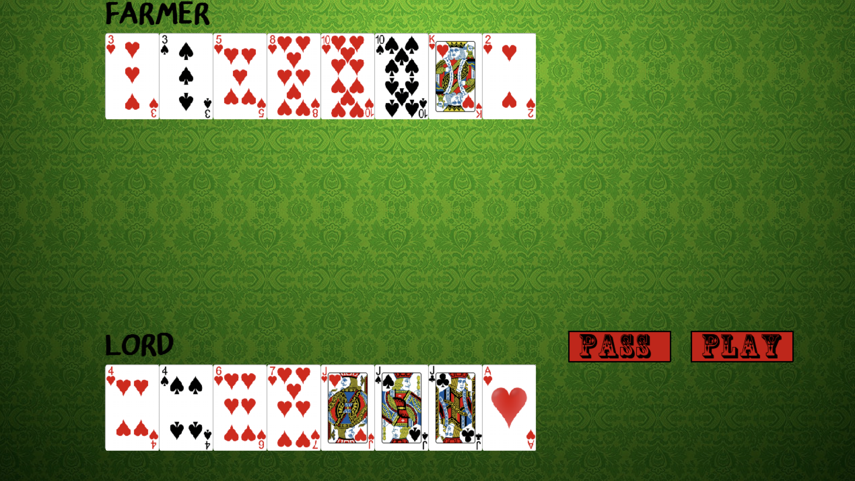
Game AI (Lord vs Farmer) Codebase (C++/Python) https://github.com/tianbingsz/LordGame

Slide 12
Game AI
Build Agents Playing Poker with Human
Generate cards by interactive adversarial self-play

